Slide 1


Design Patterns
Wieger Wesselink, j.w.wesselink@tue.nl
Joris Geurts, j.geurts@fontys.nl

Slide 2
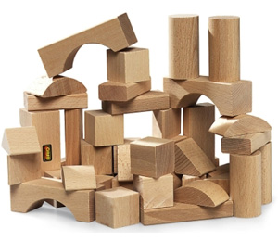
What is a design pattern?
A design pattern is a general reusable solution to a commonly occurring problem in software design.

Slide 3
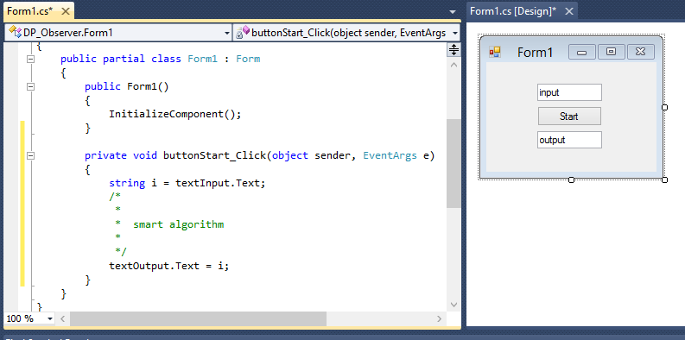
the "Form1-pattern"

Slide 4


Stock market application
(smart algorithm for stock prices)

Slide 5




Slide 6
Observer Pattern
Define a one-to-many dependency between objects where a state change in one object results with all its dependents being notified and updated automatically.

Slide 7
One-to-many relationship
observers
subject

Slide 8
Example
2
4
3

Slide 9

Publish / Subscribe

Slide 10
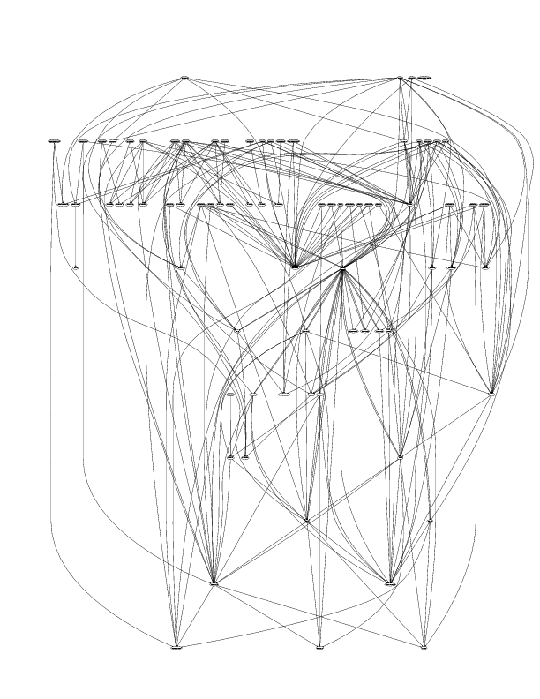
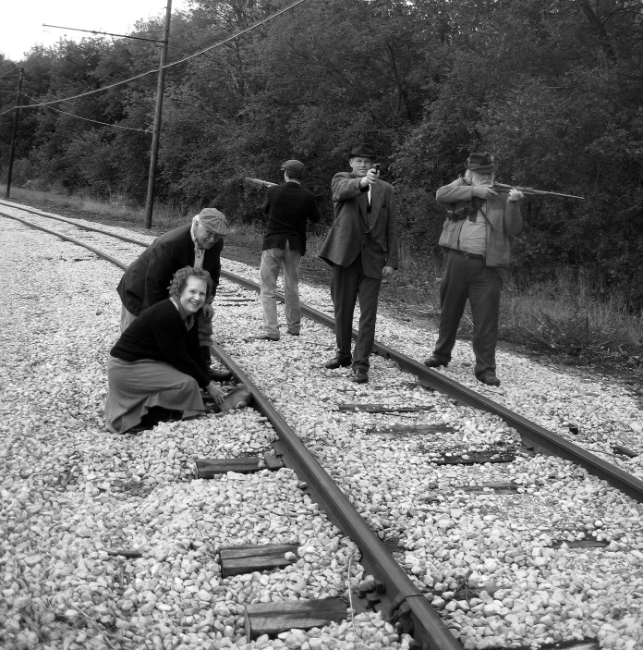
Minimize dependencies
The subject does not need/does not want to know who its observers are

Slide 11
Use interfaces
interface Subject { void Attach(Observer o); void Detach(Observer o); void Notify(); }
interface Observer { void Update(); }
observer
Attach()
Detach()
Update()
subject

Slide 12
Design principle
Strive for loosely coupled designs between objects that interact.
Loose coupling: objects can interact, but have very little knowledge about each other.

Slide 13
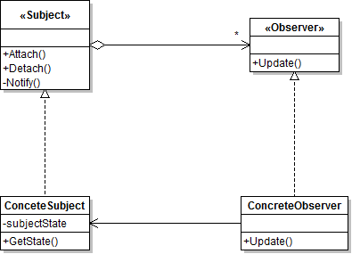
Observer solution
?

Slide 14
"implementation"
class StockSubject implements Subject { List observers;
StockState state;
Attach(Observer o)
{
observers.add(o);
}
Detach(Observer o)
{
observers.delete(o);
}
Notify()
{
foreach (o in observers)
o.Update();
}
StockState GetState()
{
return (state);
}
}
class MatrixBordStockObserver
implements Observer { Subject subject;
MatrixBordStockObserver (Subject s)
{
subject = s;
s.Attach(this);
}
Update()
{
subject.GetState();
}
}

Slide 15
Observer Consequences
+ Abstract coupling between Subject and Observer
+ Support for broadcast communication
- Unexpected updates (observer doesn't know what has been changed)

Slide 16
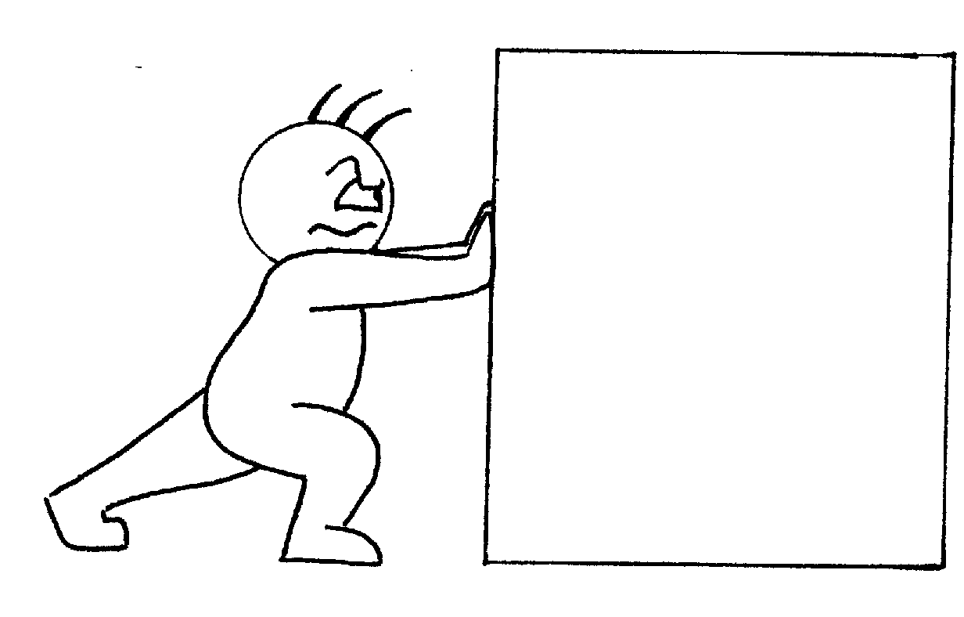
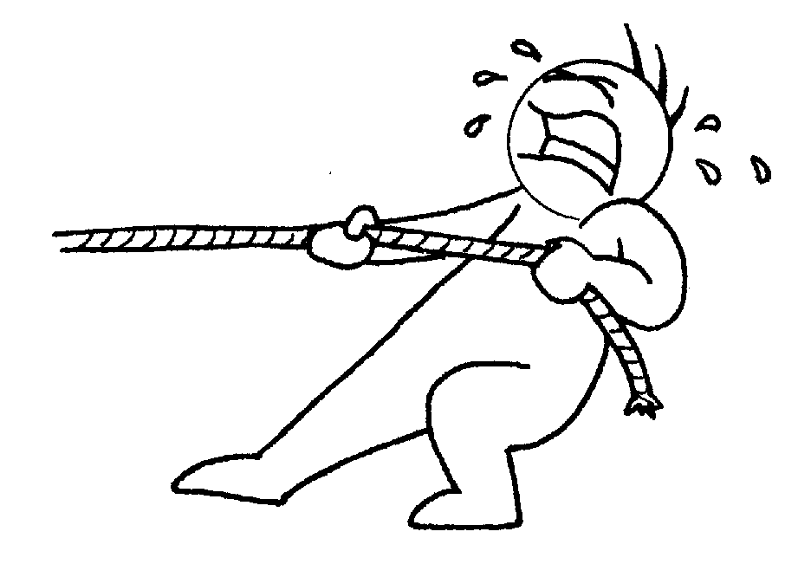
Push/Pull interface

Slide 17
Push/Pull interface
interface Observer
{
void Update(SubjectState1 s1, SubjectState2 s2);
}
interface Observer
{
void Update();
}
void Update()
{
state = subject.GetState();
}

Slide 18


Observer assignment

